Slide 1

NSG Pilkington – University of Liverpool Machine Learning Project: 18/11/2020
Dr. Peter Green
Diego Echeverria
Risk Institute,
School of Engineering

Slide 2
To-do (short-term)
Need bespoke filtering for some of the signals (we can do this with an extra column in the spreadsheet).
Establish and implement strategy for processing data that is affected by reversals.
Run the pre-processing tasks defined in the flow chart with the 168 inputs specified in the spreadsheet “UK5 AI Furnace Model Input Pre-Processing”.
To-do (longer-term)
Repeat analysis that use randomly selected inputs and/or randomly selected time lags.
Consider using a multi-output linear regression.

Slide 3
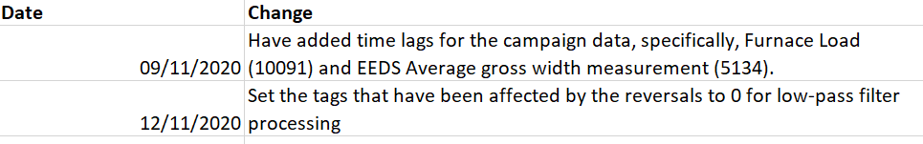
Pre-processing the inputs affected by the reversals process
Most of the inputs associated with the reversals were set to 1 for low-pass filtering in the “Model Input Pre-Processing 20201109” file.
After the 11 Nov 2020 meeting, it was recommended that we should not applied a low-pass filter because the input’s signal (identified with the reversals) were not affected by measurement noise.
Therefore, we created a change log-file ‘Model Input Pre-Processing 20201112’ where we set the low-pass filter to 0 for the inputs affected by the reversals.
We use ‘Model Input Pre-Processing 20201112’ file for the following pre-processing tasks.

Slide 4
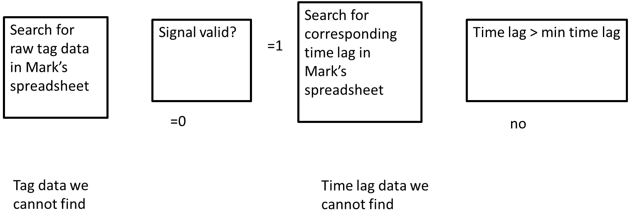
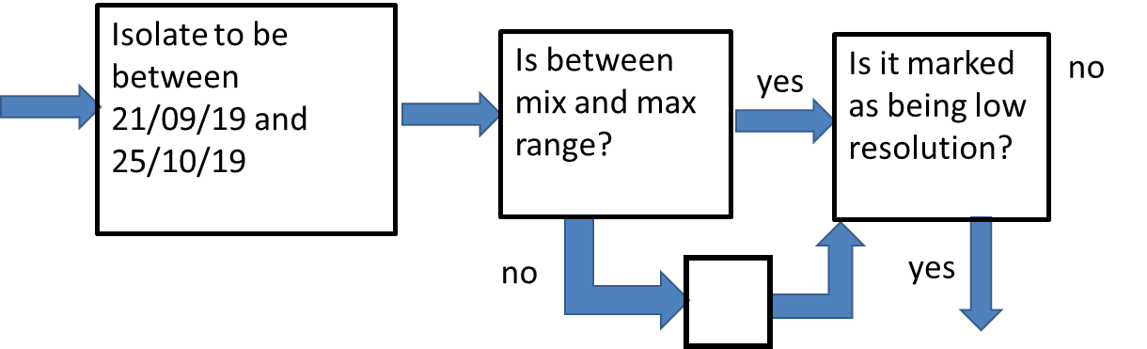
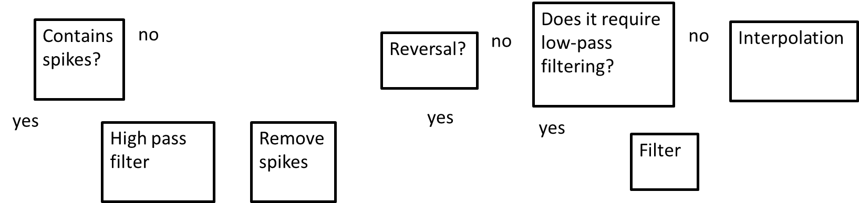
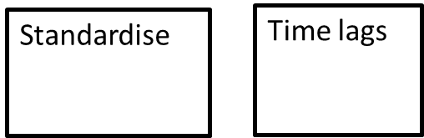
Pre-processing the inputs affected by the reversals process
Zoom in

Slide 5
Pre-processing the inputs affected by the reversals process
To create pipeline 6
Does it require low-pass filtering?
Contains spikes?
No
Apply reversals processing?
No
No
Interpolate
Yes
Remove spikes
Yes
Yes
High pass filter
Reversals
strategy
Filter

Slide 6

Strategy for processing data that is affected by the reversals
Use the standard deviation of the maximum values with a 20-minute time period
Start data processing at the minimum value of the first 20 minutes:
We search for the minimum value of the signal at the first 20 minutes to identify the point before the next firing.
Identify the maximum value within a 20-minute time period.
Get the signal values within $σ/2$ around the maximum value.

Slide 7
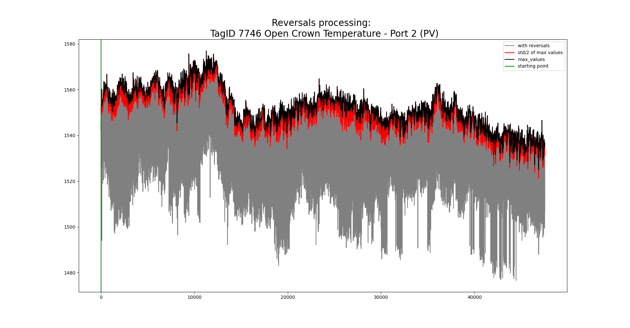
Strategy for processing data that is affected by the reversals

Slide 8
Strategy for processing data that is affected by the reversals
Zoom in

Slide 9
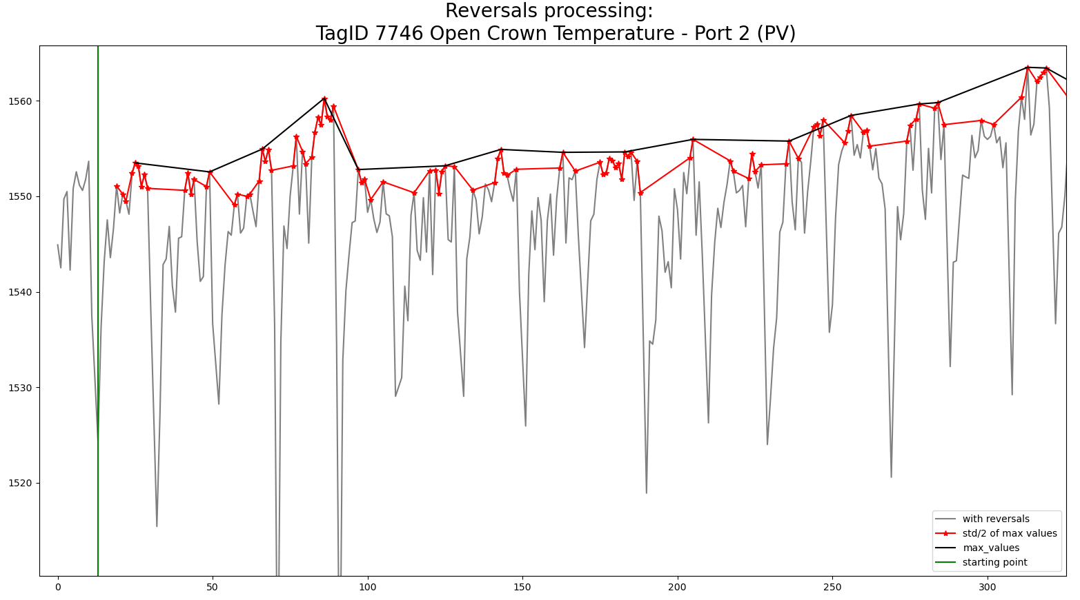

Strategy for processing data that is affected by the reversals
Starting point
Max values
* Within $σ/2$

Slide 10
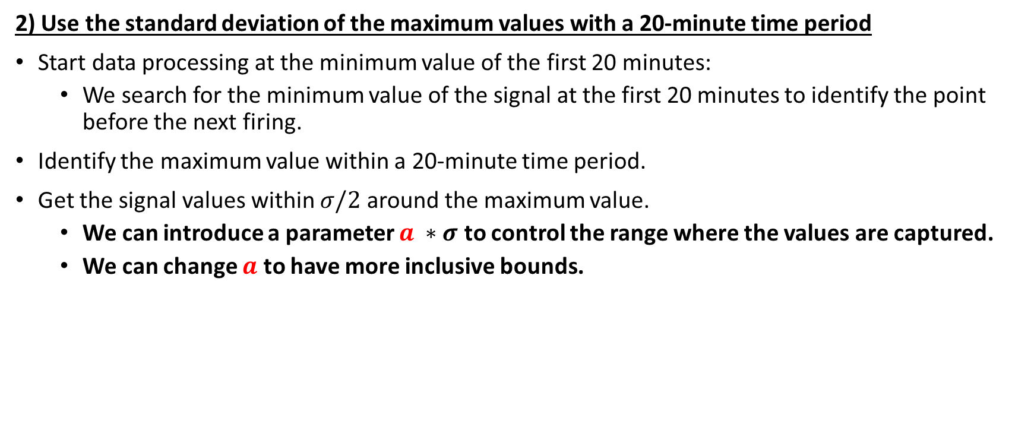
Strategy for processing data that is affected by the reversals
2) Use the standard deviation of the maximum values with a 20-minute time period
Start data processing at the minimum value of the first 20 minutes:
We search for the minimum value of the signal at the first 20 minutes to identify the point before the next firing.
Identify the maximum value within a 20-minute time period.
Get the signal values within $σ/2$ around the maximum value.
We can introduce a parameter $a ∗σ$ to control the range where the values are captured.
We can change $a$ to have more inclusive bounds.

Slide 11
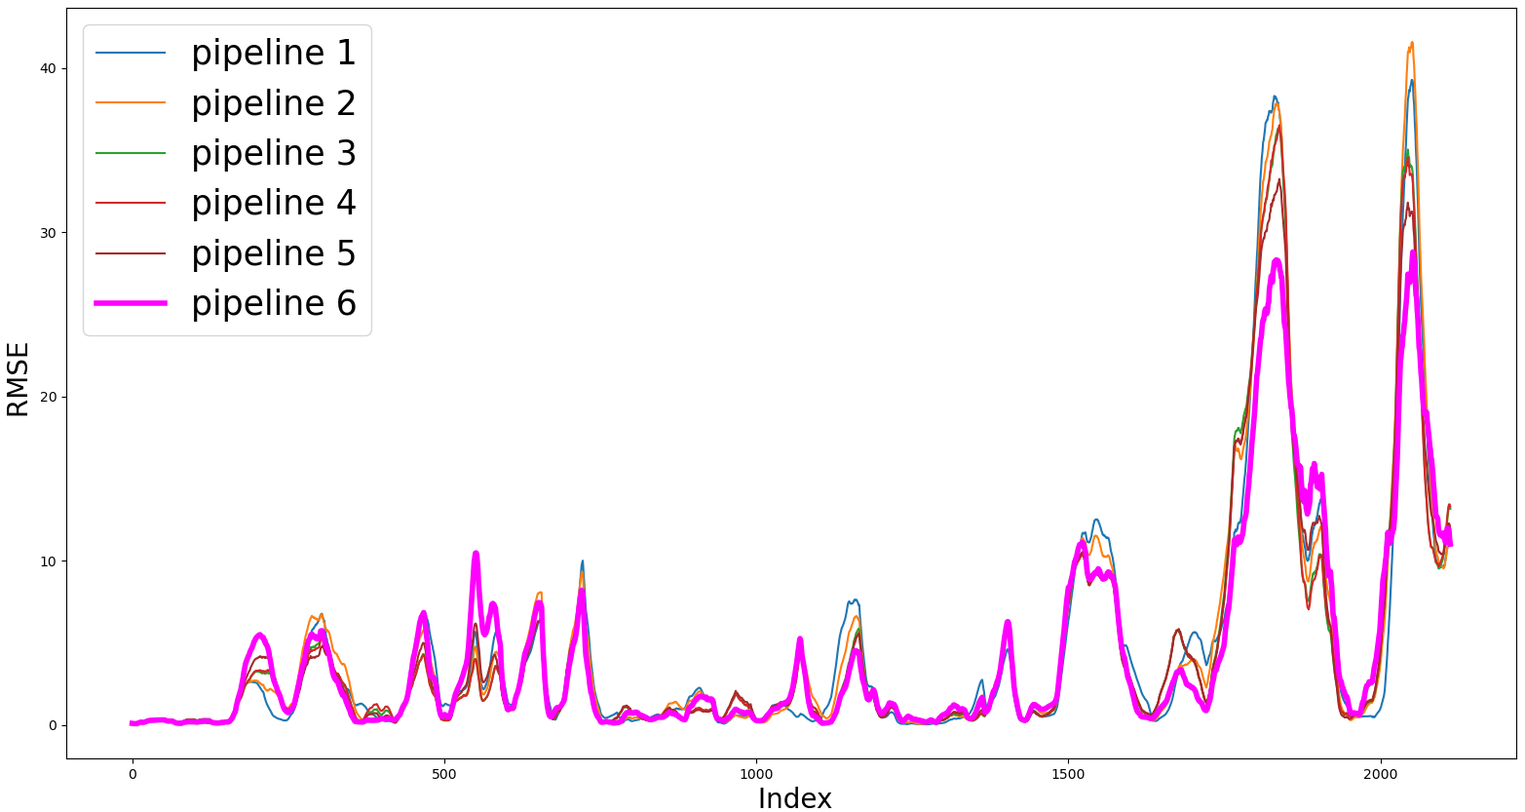
Online linear regression using data affected by the reversals: Rectified
Pipeline | Av. RMSE
1 | 4.59
2 | 4.70
3 | 4.31
4 | 4.30
5 | 4.31
6 | 4.50

Slide 12
Data processing
Machine learning
Time lags
Linear regression
Remove inputs with low importance
Model parameters
To create pipeline 7

Slide 13
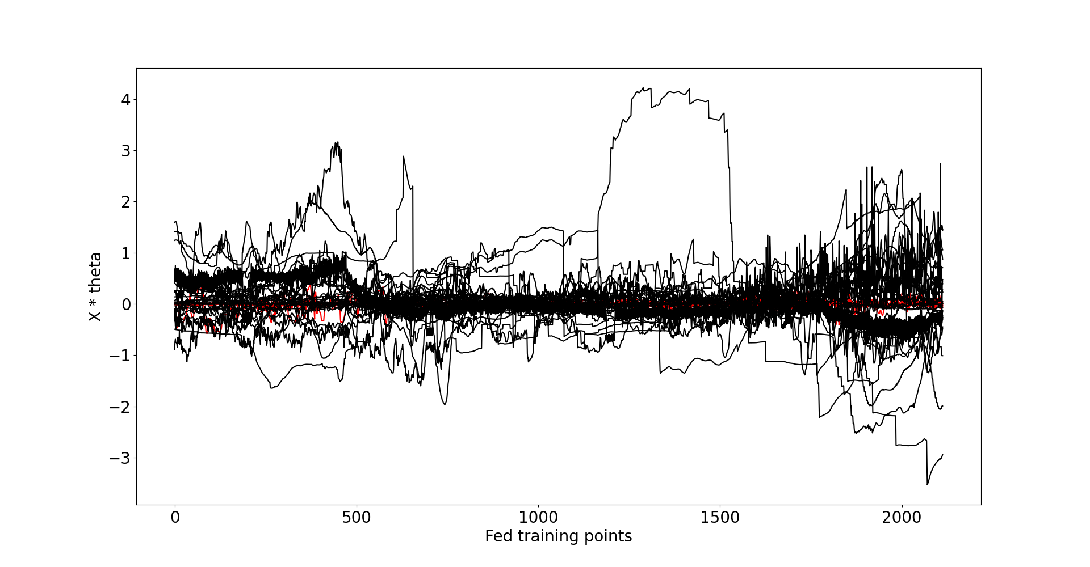
Online linear regression eliminating non-relevant tags
Inputs whose weights were always below 10%:
10279 Canal Temp Control (PV) - Also a pyromter
15119 Furnace Pressure (PV)
321 Glass Level Control (PV)
6463 Main Gas Pressure (PV)
7483 Open Crown Temperature - Port 6 (PV)
6585 Port 6 Gas Flow (PV)

Slide 14
Online linear regression eliminating non-relevant tags
Retained inputs:
10425 Calculated Cullet Ratio
1950 Canal Temp Control Pyrometer (2)
10278 Canal Temp Control (OP)
2918 Closed Bottom Temperature - Port 6 (PV)
2921 Closed Bottom Temperature - Upstream Working End (PV)
1650 Combustion Air Temperature Measurement
2911 Filling Pocket Closed Bottom Temperature LHS (PV)
11201 Furnace & Services Pack Sub S8 L.H. Section - HV13
11204 Furnace & Services Pack Sub S8 R.H. Section - HV16
11174 Furnace Bottom Temperature 18m DS of B8
10091 Furnace Load ? (t w)
9403 Furnace Pressure (OP)
9393 Glass Level Control (OP)
7474 Lehr Drive Line Shaft Speed
7746 Open Crown Temperature - Port 2 (PV)
7522 Open Crown Temperature - Port 4 (PV)
7525 Open Crown Temperature - Port 7 (PV)
7999 Outside Windspeed Anemometer
11105 Port 1 Combustion Air Flow LHS (OP)
11111 Port 2 - 3 Combustion Air Flow LHS (OP)
8390 Port 5 Gas Flow (PV)
7667 Port 7 Gas Flow (PV)
11221 Services Building MCC1 - MV67
11217 Services Building MCC9 Cat B Supply - MV60
8344 Total CCCW Flow Measurement
136 Total Combustion Air Flow Measurement
135 Total Firm Gas Flow Measurement
9282 Tweel Position
30060 U S Flowing End Air Flow Measurement
11384 Wobbe Index (Incoming Gas)

Slide 15
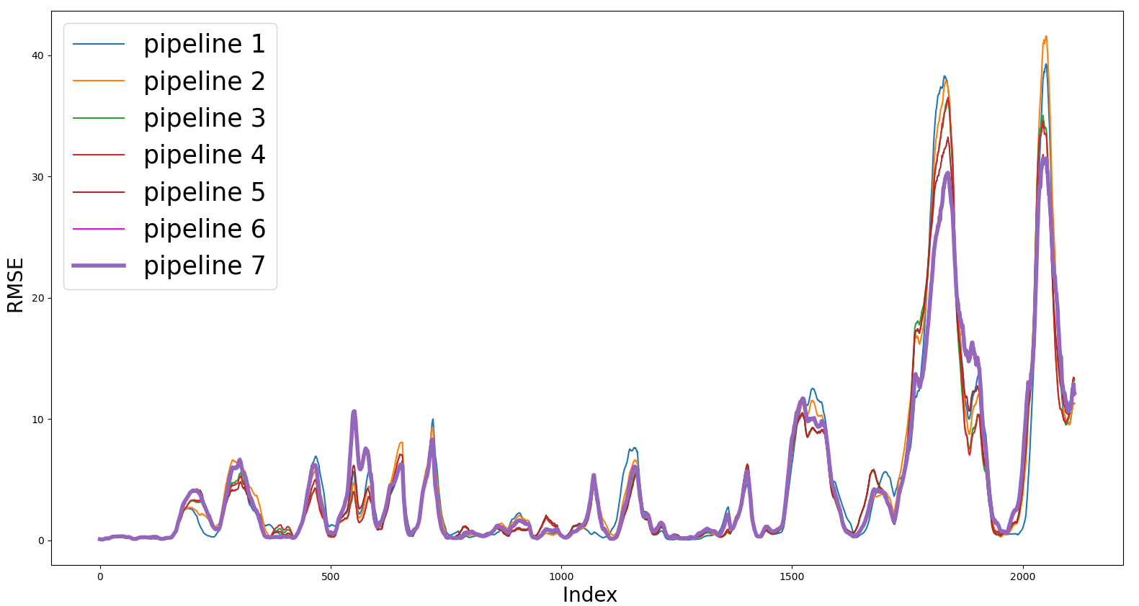
Online linear regression using data affected with the reversals, rectified and filtered
Pipeline | Av. RMSE
1 | 4.59
2 | 4.70
3 | 4.31
4 | 4.30
5 | 4.31
6 | 4.50
7 | 4.27

Slide 16
Pre-processing the inputs affected by the reversals process
To create pipeline 8
Does it require low-pass filtering?
Contains spikes?
No
Apply reversals processing?
No
No
Interpolate
Yes
Remove spikes
Yes
Yes
High pass filter
Reversals
strategy
Filter

Slide 17
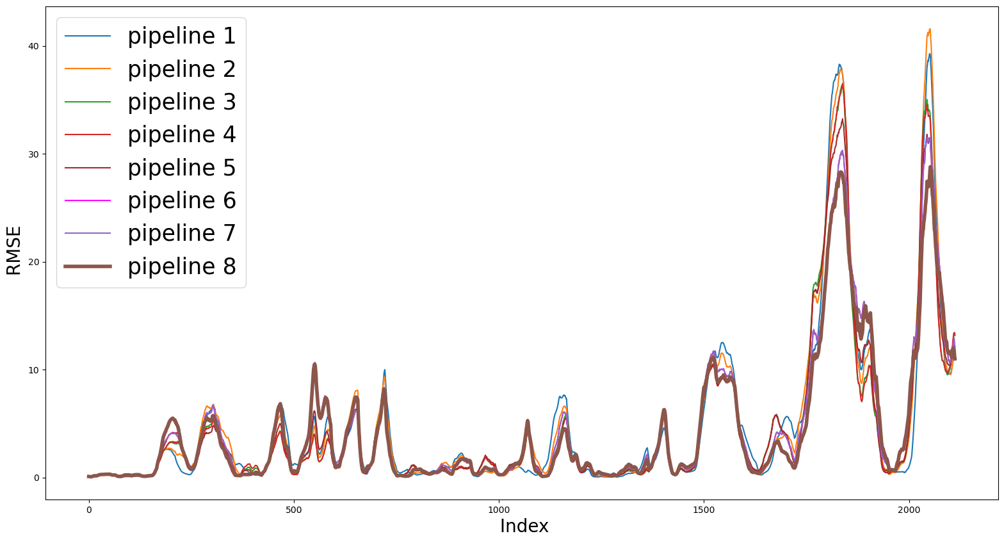
Online linear regression using data affected with the reversals: Rectified and filtered
Pipeline | Av. RMSE
1 | 4.59
2 | 4.70
3 | 4.31
4 | 4.30
5 | 4.31
6 | 4.50
7 | 4.27
8 | 4.25

Slide 18
Data processing
Machine learning
Time lags
Linear regression
Remove inputs with low importance
Model parameters
To create pipeline 9

Slide 19
Online linear regression eliminating non-relevant tags
Inputs whose weights were always below 10%:
10279 Canal Temp Control (PV) - Also a pyromter
15119 Furnace Pressure (PV)
321 Glass Level Control (PV)
6463 Main Gas Pressure (PV)

Slide 20
Online linear regression eliminating non-relevant tags
Retained inputs:
10425 Calculated Cullet Ratio
1950 Canal Temp Control Pyrometer (2)
10278 Canal Temp Control (OP)
2918 Closed Bottom Temperature - Port 6 (PV)
2921 Closed Bottom Temperature - Upstream Working End (PV)
1650 Combustion Air Temperature Measurement
2911 Filling Pocket Closed Bottom Temperature LHS (PV)
11201 Furnace & Services Pack Sub S8 L.H. Section - HV13
11204 Furnace & Services Pack Sub S8 R.H. Section - HV16
11174 Furnace Bottom Temperature 18m DS of B8
10091 Furnace Load ? (t w)
9403 Furnace Pressure (OP)
9393 Glass Level Control (OP)
7474 Lehr Drive Line Shaft Speed
7746 Open Crown Temperature - Port 2 (PV)
7522 Open Crown Temperature - Port 4 (PV)
7483 Open Crown Temperature - Port 6 (PV)
7525 Open Crown Temperature - Port 7 (PV)
7999 Outside Windspeed Anemometer
11105 Port 1 Combustion Air Flow LHS (OP)
11111 Port 2 - 3 Combustion Air Flow LHS (OP)
8390 Port 5 Gas Flow (PV)
6585 Port 6 Gas Flow (PV)
7667 Port 7 Gas Flow (PV)
11221 Services Building MCC1 - MV67
11217 Services Building MCC9 Cat B Supply - MV60
8344 Total CCCW Flow Measurement
136 Total Combustion Air Flow Measurement
135 Total Firm Gas Flow Measurement
9282 Tweel Position
30060 U S Flowing End Air Flow Measurement
11384 Wobbe Index (Incoming Gas)

Slide 21
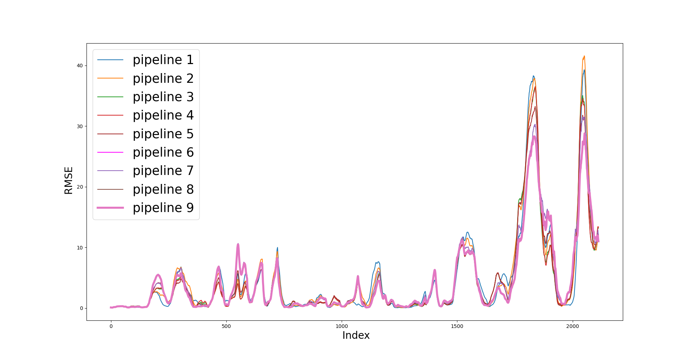
Online linear regression eliminating non-relevant tags
Pipeline | Av. RMSE
1 | 4.59
2 | 4.70
3 | 4.31
4 | 4.30
5 | 4.31
6 | 4.50
7 | 4.27
8 | 4.25
9 | 4.18

Slide 22
To-do (short-term)
Need bespoke filtering for some of the signals (we can do this with an extra column in the spreadsheet).
Establish and implement strategy for processing data that is affected by reversals.
Run the pre-processing tasks defined in the flow chart with the 168 inputs specified in the spreadsheet “UK5 AI Furnace Model Input Pre-Processing”.
To-do (longer-term)
Repeat analysis that use randomly selected inputs and/or randomly selected time lags.
Consider using a multi-output linear regression.

Slide 23
Multi-output linear regression
Lag 2
Fault
Density
Time
Lag 1
Tag 1
Time
Tag 2
Time

Slide 24
Multi-output linear regression
Lag 2
Fault
Density
Time
Lag 1
Tag 1
Time
Tag 2
Time

Slide 25
Multi-output linear regression (now including previous fault density)
Lag 2
Fault
Density
Time
Lag 1
Tag 1
Time
Tag 2
Time

Slide 26
Multi-output linear regression (now including previous fault density)
Lag 2
Fault
Density
Time
Lag 1
Tag 1
Time
Tag 2
Time

Slide 27
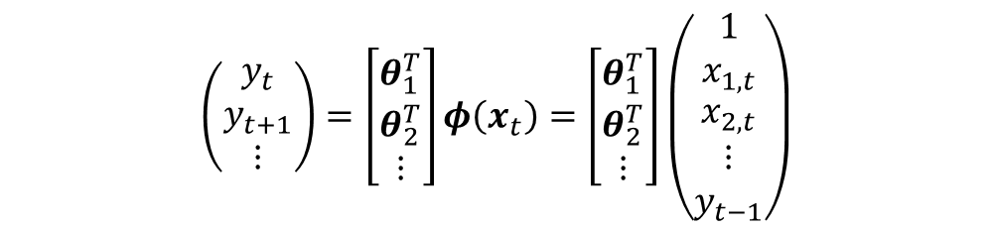
$$\left(\begin{matrix}y_{t} \\ y_{t+1} \\ ⋮\end{matrix}\right)=\left[\begin{matrix}θ_{1}^{T} \\ θ_{2}^{T} \\ ⋮\end{matrix}\right]φ\left(x_{t}\right)=\left[\begin{matrix}θ_{1}^{T} \\ θ_{2}^{T} \\ ⋮\end{matrix}\right]\left(\begin{matrix}\begin{matrix}1 \\ x_{1,t}\end{matrix} \\ \begin{matrix}x_{2,t} \\ \begin{matrix}⋮ \\ y_{t−1}\end{matrix}\end{matrix}\end{matrix}\right)$$

Slide 28
Constant
$$\left(\begin{matrix}y_{t} \\ y_{t+1} \\ ⋮\end{matrix}\right)=\left[\begin{matrix}θ_{1}^{T} \\ θ_{2}^{T} \\ ⋮\end{matrix}\right]φ\left(x_{t}\right)=\left[\begin{matrix}θ_{1}^{T} \\ θ_{2}^{T} \\ ⋮\end{matrix}\right]\left(\begin{matrix}\begin{matrix}1 \\ x_{1,t}\end{matrix} \\ \begin{matrix}x_{2,t} \\ \begin{matrix}⋮ \\ y_{t−1}\end{matrix}\end{matrix}\end{matrix}\right)$$
Previous fault density

Slide 29

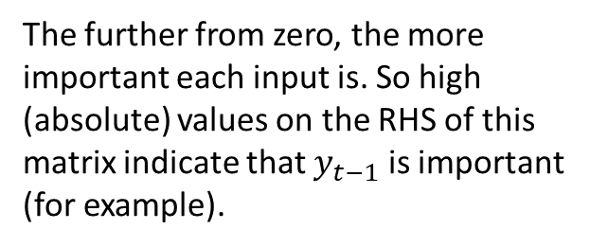
Constant
$$\left(\begin{matrix}y_{t} \\ y_{t+1} \\ ⋮\end{matrix}\right)=\left[\begin{matrix}θ_{1}^{T} \\ θ_{2}^{T} \\ ⋮\end{matrix}\right]φ\left(x_{t}\right)=\left[\begin{matrix}θ_{1}^{T} \\ θ_{2}^{T} \\ ⋮\end{matrix}\right]\left(\begin{matrix}\begin{matrix}1 \\ x_{1,t}\end{matrix} \\ \begin{matrix}x_{2,t} \\ \begin{matrix}⋮ \\ y_{t−1}\end{matrix}\end{matrix}\end{matrix}\right)$$
Previous fault density
The further from zero, the more important each input is. So high (absolute) values on the RHS of this matrix indicate that $y_{t−1}$ is important (for example).
$$θ_{n}^{T}$$

Slide 30
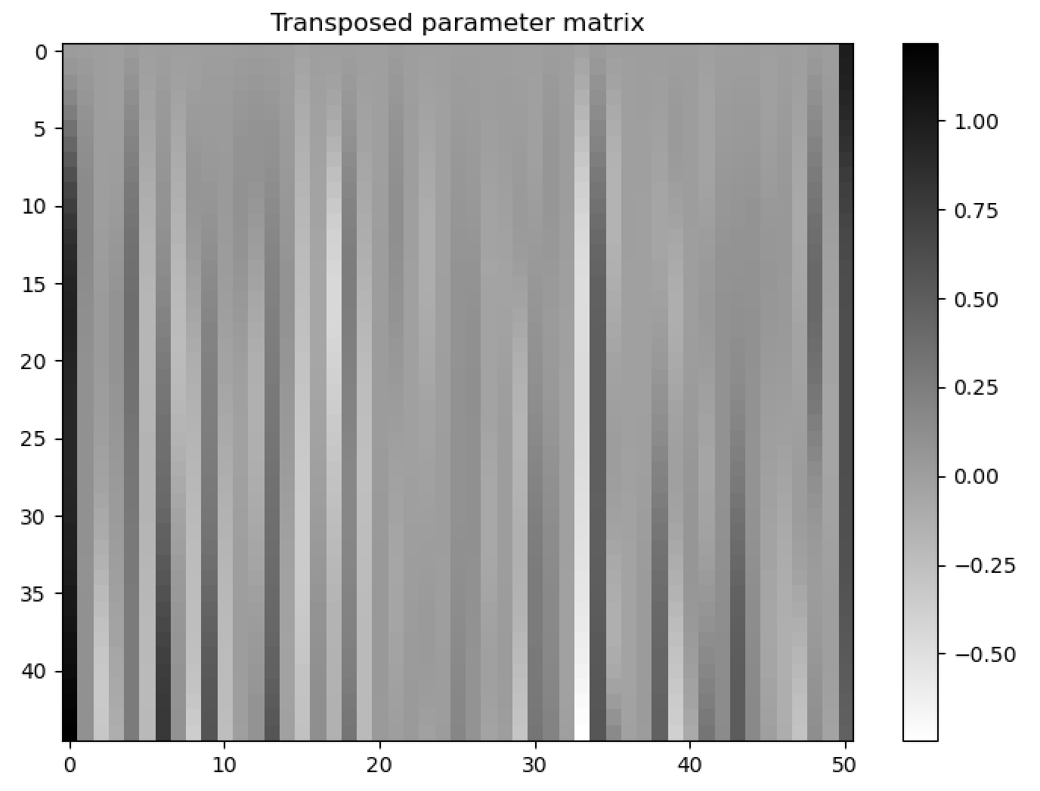
After batch training

Slide 31

After batch training
$$y_{t}≈y_{t−1}$$

Slide 32
After batch training
Becomes less important as we look further into the future

Slide 33
After batch training
Some inputs become increasingly important

Slide 34
After batch training
Some inputs have a ‘time window’ where they are important

Slide 35
Still some work to do…
Is currently ‘batch’, not online
Training lots of linear regression models currently isn’t equivalent to training the multi-output linear regression model; need to check this!
Does raise some difficult questions… What should we do with the time lags?
Could potentially optimise different models for predicting different lengths into the future (we’re good at 8 hours, but 4 hours needs improvement etc.)

Slide 36
Conclusions
The reversals pre-processing strategy with the previous specified pre-processing tasks seems to outcome better quality of inputs and thus, better predictors.
Identifying non-relevant tags with the Linear Regression parameters and eliminating them, is still a good way to improve the predictive performance of the model.
Multi-output regression appears to have potential but further work still needed.

Slide 37
Next activities
To-do (short-term)
Need bespoke filtering for some of the signals (we can do this with an extra column in the spreadsheet).
Run the pre-processing tasks defined in the flow chart with the 168 inputs specified in the spreadsheet “UK5 AI Furnace Model Input Pre-Processing”.
To-do (longer-term)
Repeat analysis that use randomly selected inputs and/or randomly selected time lags.
Consider using a multi-output linear regression.

Slide 38
Thank you for your attention. ANY QUESTIONS?

